Slide 1


Leo: The Personal Voice Assistant
Leo is a Python-based personal voice assistant designed to simplify your daily tasks. Using voice commands, you can perform actions like searching the web, controlling your system, playing music, and much more.
Mohammad Aas Khan
22052561
CSE-41
DAA-LAB

Slide 2

Introduction to Leo
1
Purpose
2
Capabilities
Leo's primary purpose is to enhance your productivity and streamline your daily routine by providing a convenient and accessible voice-controlled interface.
Leo can perform various tasks, including web searches, system control, YouTube playback, and more, making it a versatile tool for everyday use.
3
Modularity
Leo's modular design allows for easy expansion and customization, enabling you to add new functionalities and adapt the assistant to your specific needs.

Slide 3

Project Overview
Web Search
Time and Temperature
Leo can search Google, Wikipedia, and YouTube for information, providing quick and convenient access to a wide range of resources.
Leo can retrieve the current time and local temperature, keeping you informed about the weather and time.
App Management
Modular Design
Leo can open and close desktop applications, making it easy to access your favorite programs with a simple voice command.
Leo's modular structure ensures maintainability and scalability, allowing for easy updates and additions of new functionalities.

Slide 4
Architecture and Directory Structure
File Structure
Purpose
main.py initializes the assistant, while core_utils.py contains reusable helper functions.
leo_assistant/ ├── main.py ├── core_utils.py └── functions/ ├── greet_user.py ├── web_search.py ├── time_check.py ├── temperature_check.py └── app_management.py
The functions/ folder holds individual modules for specific tasks, such as web search, time check, and app management.

Slide 5
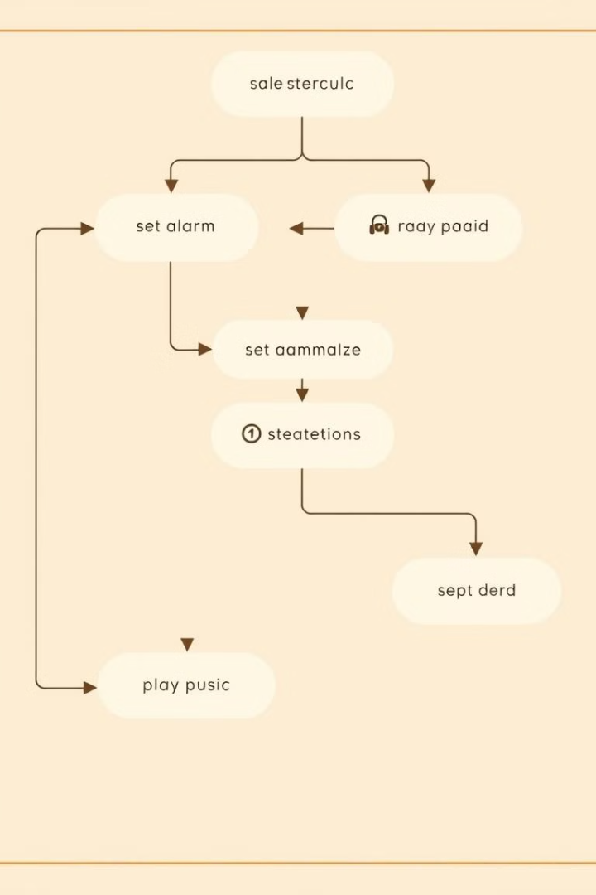
Key Functionalities (1/2)
1
Greeting
2
Web Search
Leo greets the user based on the time of day, providing a personalized and engaging interaction.
Leo can search Google, Wikipedia, and YouTube for information, making it a versatile resource for quick answers and web browsing.
3
Time and Temperature Check
4
App Management
Leo can open and close desktop applications, allowing you to easily access your favorite programs with a simple voice command.
Leo can retrieve the current time and local temperature, providing helpful information for planning your day or staying informed about the weather.

Slide 6

Key Functionalities (2/2)
1
YouTube Control
2
System Control
Leo can play, pause, and adjust playback of YouTube videos, providing seamless control over your video viewing experience.
Leo can shut down or restart the computer, making it easy to manage your system with a simple voice command.
3
Volume Control
4
Rock-Paper-Scissors
Leo can adjust the system volume using shortcuts, allowing for convenient control over your audio output.
Leo offers a fun interactive game of rock-paper-scissors, providing entertainment and a break from routine tasks.

Slide 7
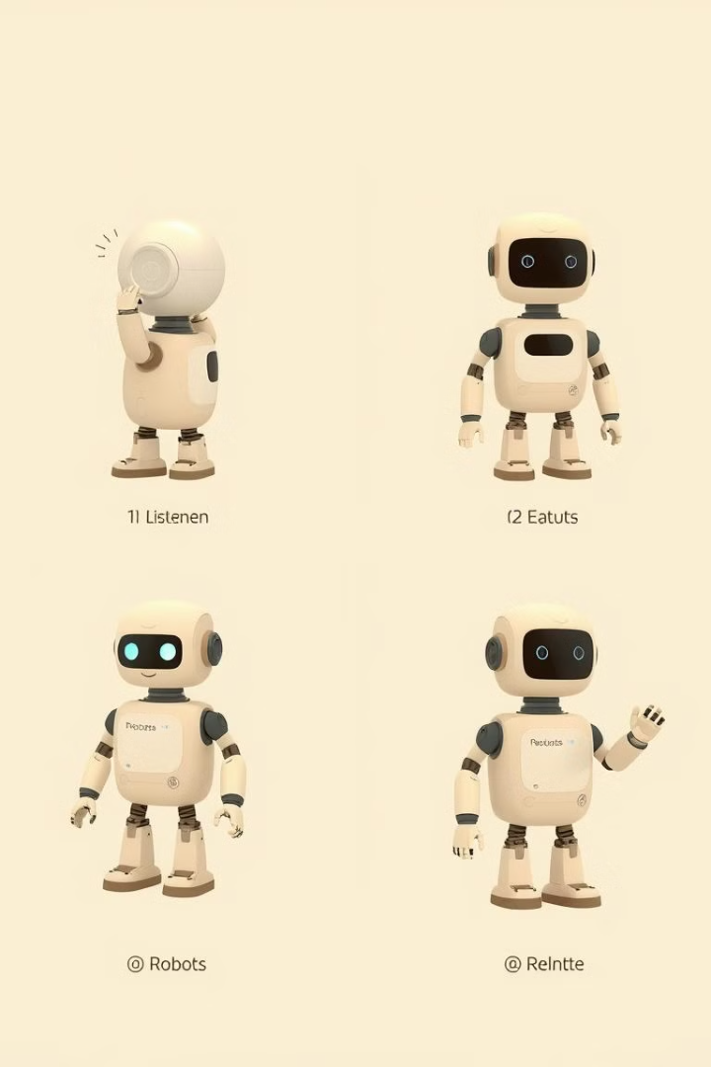




Workflow of the Assistant
Listen
Leo receives the user's voice command, capturing the spoken input.
Process
Leo decodes the command and determines the user's intent, analyzing the keywords and context.
Execute
Leo calls the relevant function based on the identified intent, carrying out the requested action.
Respond
Leo provides audio and/or text feedback, confirming the action or providing the requested information.

Slide 8
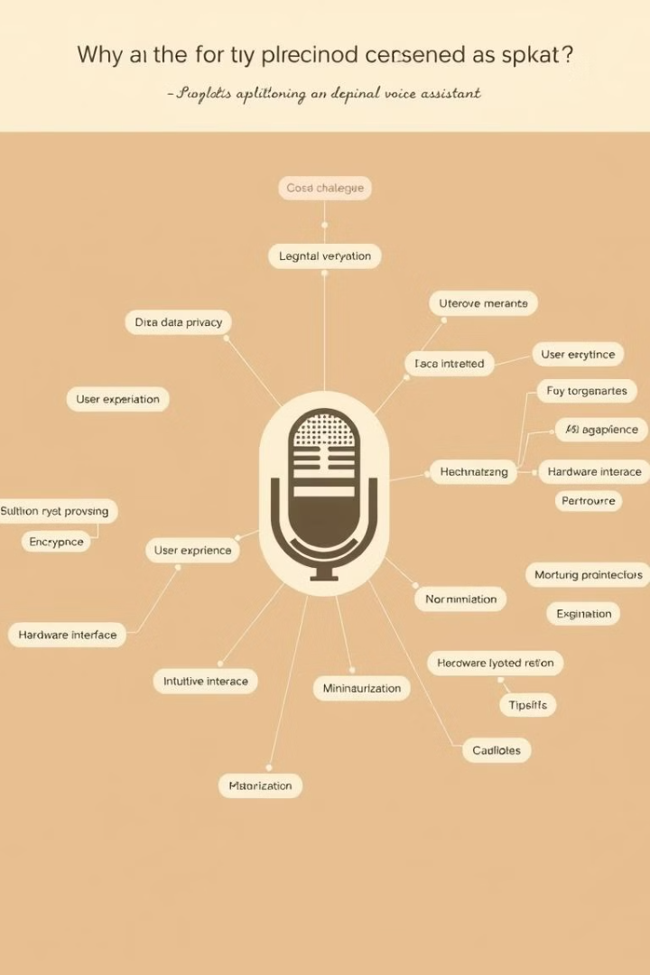
Challenges and Solutions
Challenges
Solutions
Voice recognition accuracy
Utilized speech_recognition's error handling features for improved accuracy.
Modular imports and redundancy
Structured code into well-defined modules to simplify debugging and avoid redundancies.
Error handling for system shutdown or internet speed checks
Implemented robust error handling mechanisms to ensure smooth operation in various scenarios.

Slide 9

Future Enhancements
1
Natural Language Processing (NLP)
2
Service Integration
Integrating with services like email, calendar reminders, and social media would expand Leo's functionality and usefulness.
Implementing NLP would enable Leo to understand more complex and natural language commands, leading to a more intuitive interaction.
3
Memory Functions
4
Advanced GUI
Integrating a database would allow Leo to remember user preferences, past interactions, and relevant information for improved personalization.
Developing a user-friendly GUI would enhance the visual experience and make Leo more accessible to a broader audience.

Slide 10

Conclusion
Leo is a modular and versatile personal voice assistant that offers a wide range of functionalities to simplify daily tasks and enhance productivity. The project showcases the power of modular design, enabling easy extensibility and customization.
Thank you for your time!

Slide 11
Thank You
We appreciate your time and interest in Leo, the personal voice assistant. We hope this presentation has provided valuable insights into the project.

